Slide 1
PRUEBAS INSTALACION SQL SERVER 2025 + MANAGEMENT STUDIO

Slide 2
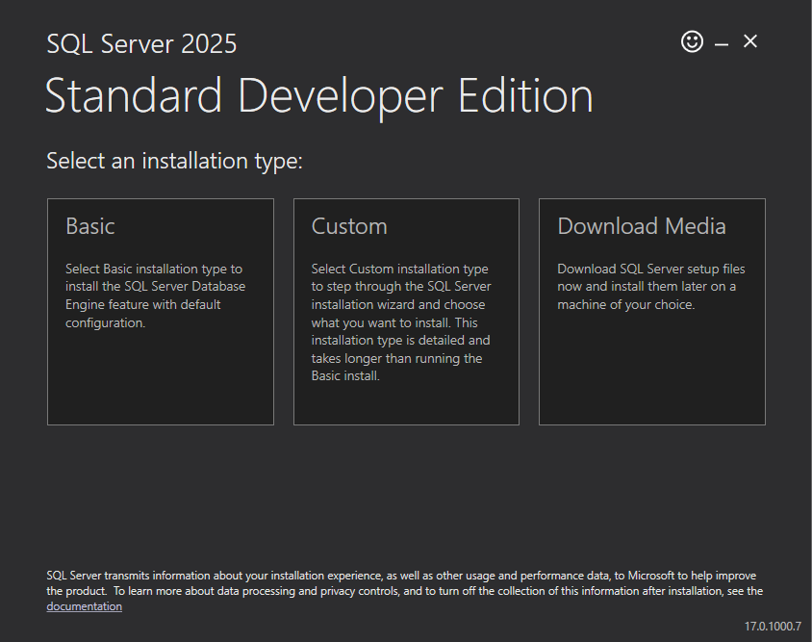
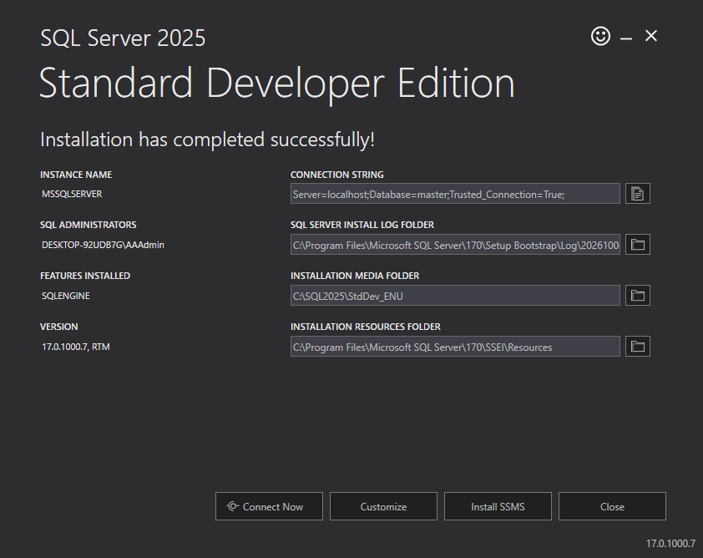
SQL SERVER DEVELOPER EDITION 2025

Slide 3
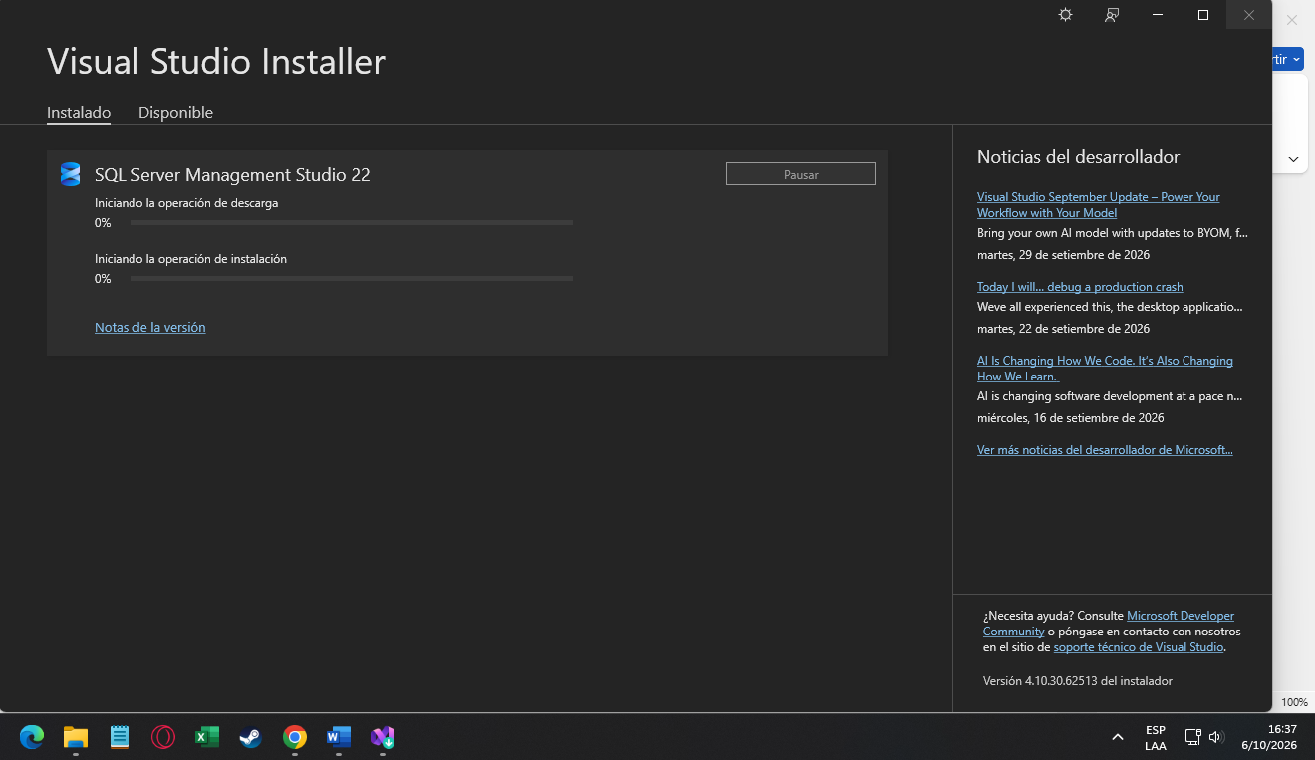
SQL SERVER MANAGEMENT STUDIO

Slide 4
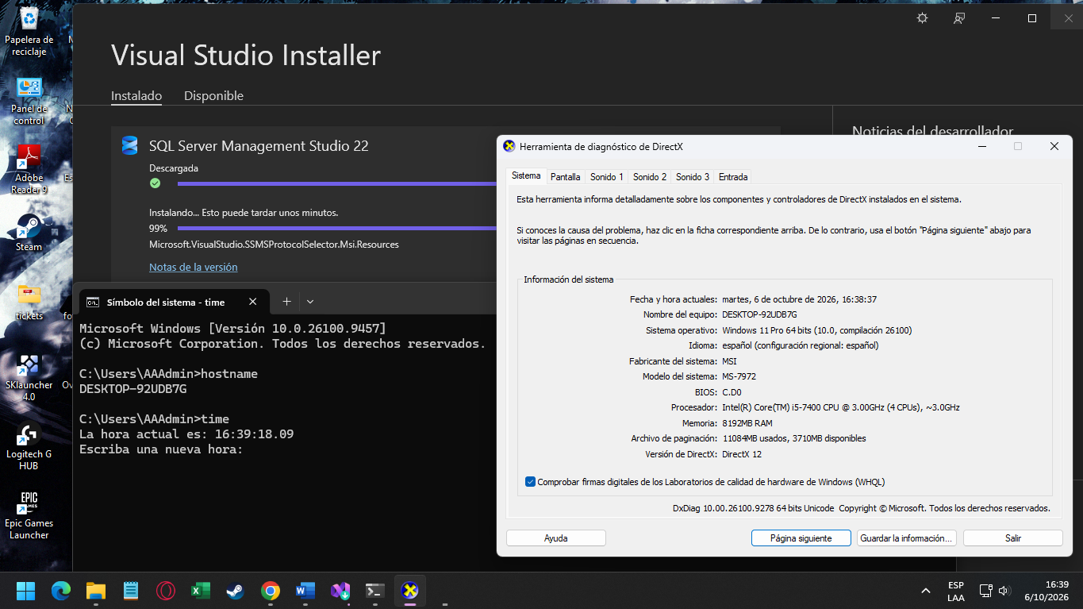

Slide 5
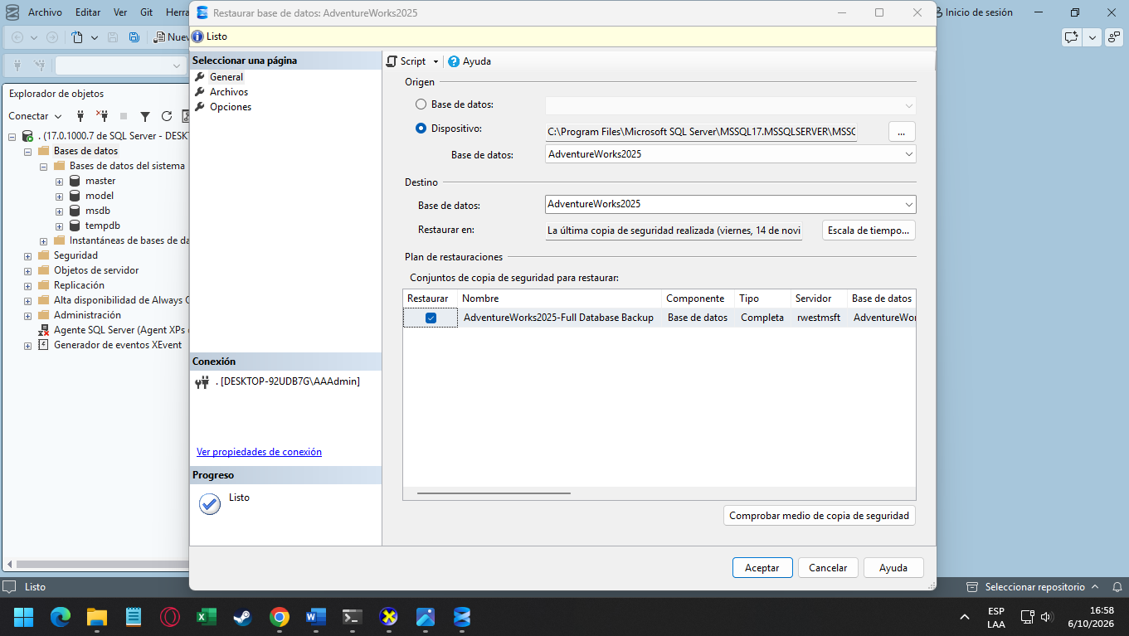

Slide 6
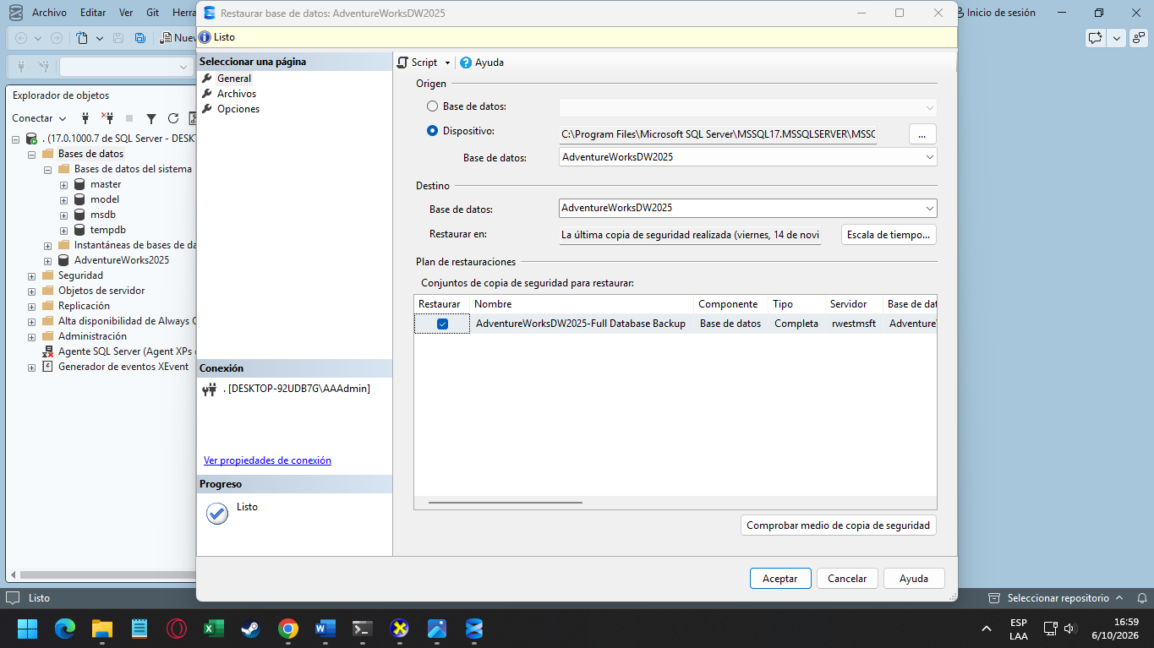

Slide 7
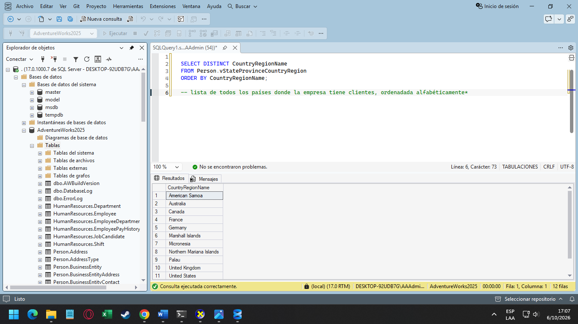
CONSULTA SELECT ADVENTUREWORKS 2025

Slide 8
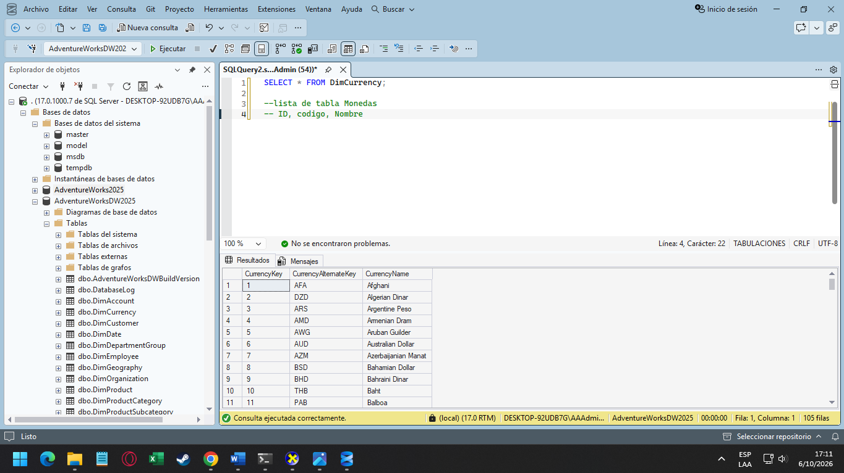
CONSULTA SELECT ADVENTUREWORKSDW 2025

Slide 9
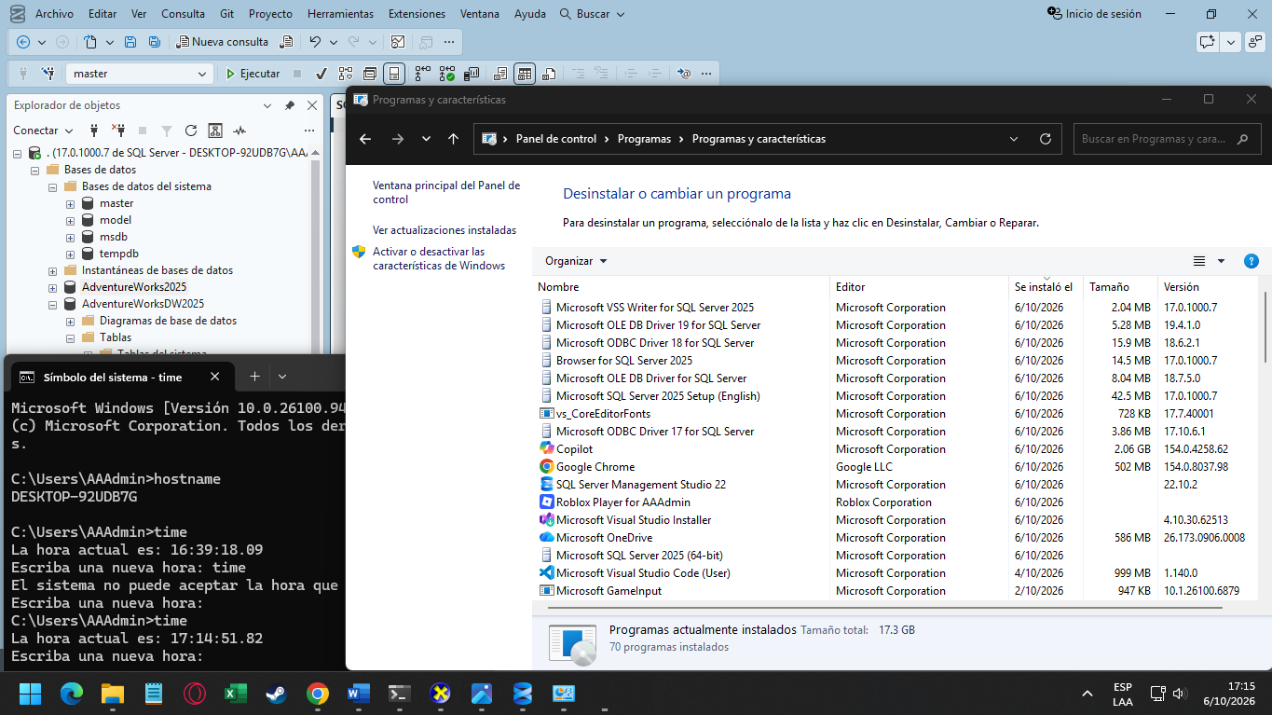

Slide 10
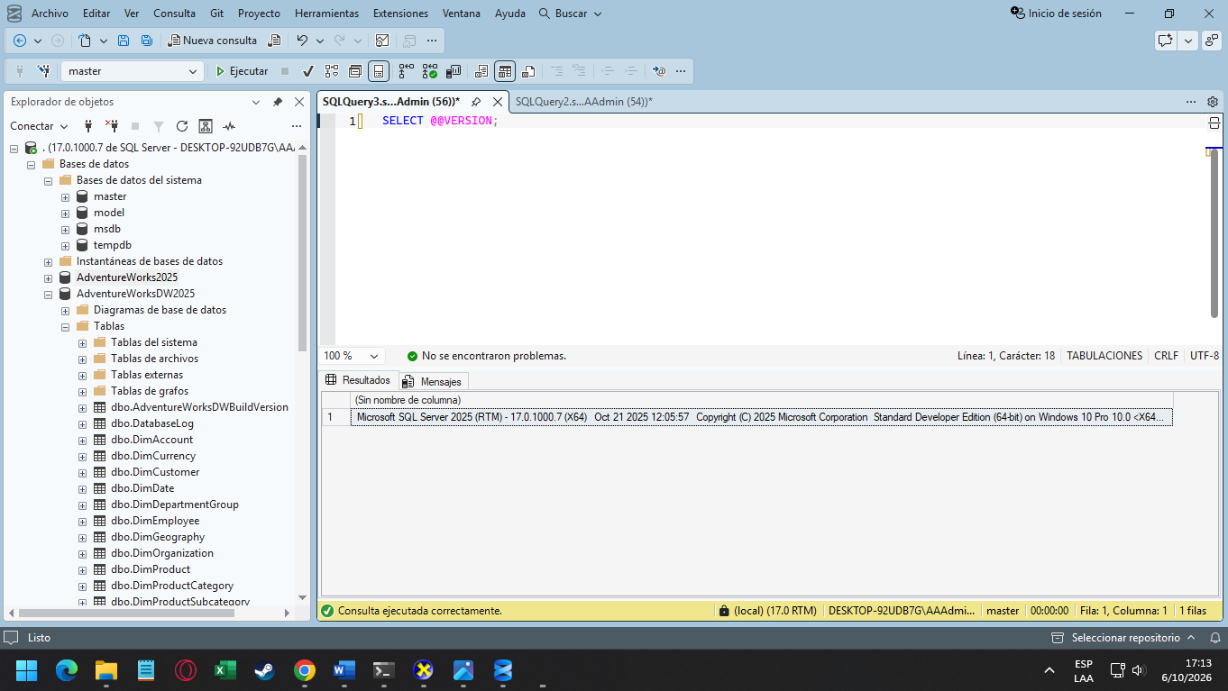
VERSION

